Slide 1

Applying LLMs to Infer Consistency Rules in Property Graph Data
Supervised by Andrea Mauri
Malvina Michaloudi
M2 DISS 2023-2024
04/09/2024
Notes:
Welcome to my presentation on Applying LLMs to Infer Consistency Rules in Property Graph Data.
Today I will explore how Large Language Models can be leveraged in identifying consistency rules in property graph data.

Slide 2
Introduction
Complex graph structures
Usage of graph databases in multiple domains
Consistency and integrity in graph databases pose challenges
Large Language Models :
Transformative tools
Generate human-like text
Multiple of tasks
Interpret and manipulate graph data
Notes:
The explosion of data has led to increasingly complex and interconnected graph structures. Graph databases are used across various domains such as social networks and entertainment industries.
Ensuring consistency and integrity of these databases pose significant challenges.
LLMs have emerged as transformative tools in natural language processing.
They can generate human-like text and understand complex language patterns.
LLMs have shown remarkable potential in a variety of tasks such as text generation and question answering.
Large Language Models can be adapted to interpret and manipulate graph data providing a new approach to extracting consistency rules.

Slide 3
Significance of the Problem
Rule-Base Data Repair Methods Limitations
Reliance on modules processing each data type in isolation
Struggling with diverse content
Large Language Models Benefits
Learn from vast amounts of data
Minimal Human Intervention
Automation and Intelligence
Notes:
Rule-base data repair methods rely on modules designed to process each data type in isolation and struggle when the content is diverse.
These limitations fall short when dealing with the complexity of modern graph databases.
Large Language Models offer a solution to this problem with their ability to learn from large-scale data.
The human intervention is reduced and this brings in automation and intelligence to the process and this reduce the time and resources required for data maintenance.

Slide 4
Problem Statement
How can Large Language Models (LLMs) be utilized to infer consistency rules within complex graph structures?
Notes:
This research explores how Large Language Models can be utilized to generate consistency rules within graph databases. The expected outcomes include demonstrating the effectiveness of Large Language Models in this context.

Slide 5
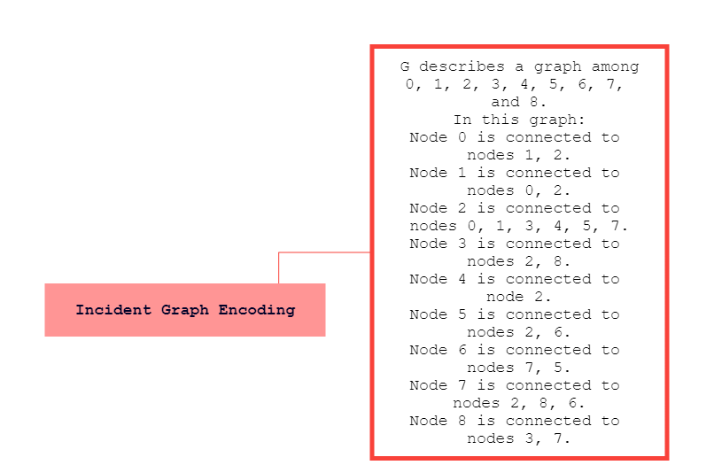
LLM-based Rule Detection
Encoding Graph as Text
Notes:
In order to make an LLM understand the graph it needs to be encoded into textual format.
The process of encoding graphs as text can be separated into first the encoding of nodes in the graph and second the encoding of edges between nodes.
Regarding the encoding of nodes the incident graph encoding uses the integer encoding Node 0
Regarding the encoding of edges the incident graph encoding uses the incident encoding where the source node is connected to target node.

Slide 6
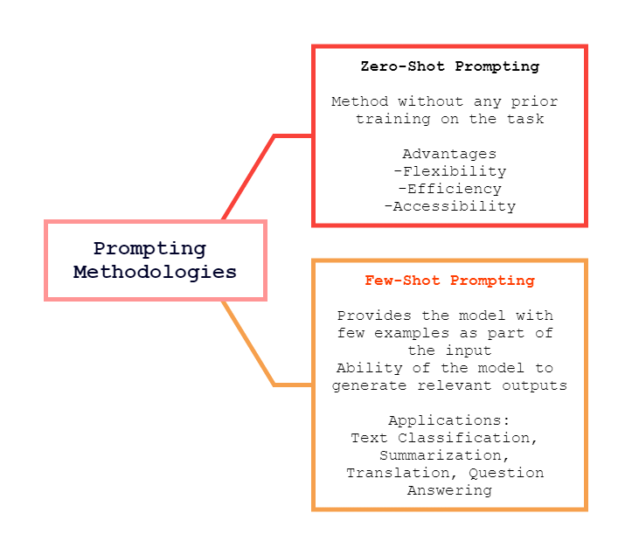
LLM-based Rule Detection
Prompting Methodologies
Notes:
Two prompting methodologies are implemented to guide Large Language Models in generating consistency rules
The Zero Shot is a prompting method which simply provides the model with task description and asks it to generate the desired output without any prior training
Three advantages of this method are :
Flexibility
Efficiency
Accessibility
A simple example is Given as task description the sentence Translate English to French
And as prompt the word cheese
Few Shot is an approach where the model is given a few number of examples to help it understand how to perform a specific task. The model then learns from these examples and uses them to generate relevant outputs. It can be used in various applications such as text classification, summarization, translation and question answering
A simple example is Given as task description the sentence Translate English to French
Then three examples from words that have been translated from English to French and as prompt again the word cheese.

Slide 7
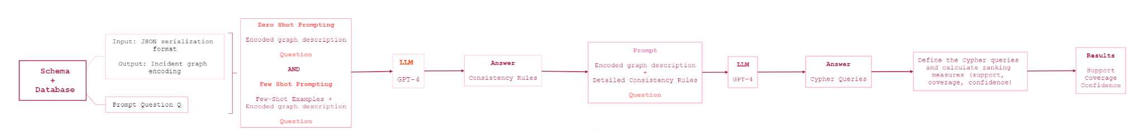
Methodology
General Pipeline
Notes:
This pipeline is the methodology followed during this study.
Both the schema and the data were converted at the beginning into the JSON serialization format and then encoded using incident graph encoding.
Then for generating consistency rules the Zero Shot and the Few Shot have been applied.
The pre-trained generative AI model Large Language Model of GPT-4 is employed to extract consistency rules from the encoded graph schema and the encoded graph database through zero-shot and few-shot prompting methodologies
These rules might dictate constraints on node attributes or the connections between those entities.
Then, the quality of the inferred consistency rules is evaluated by calculating ranking measures such as support, coverage and confidence. This involves testing the rules against the graph dataset to identify any inconsistencies or errors they can detect. The evaluation process ensures that the rules are effective in maintaining data integrity and are applicable to the specific characteristics of the graph data.

Slide 8
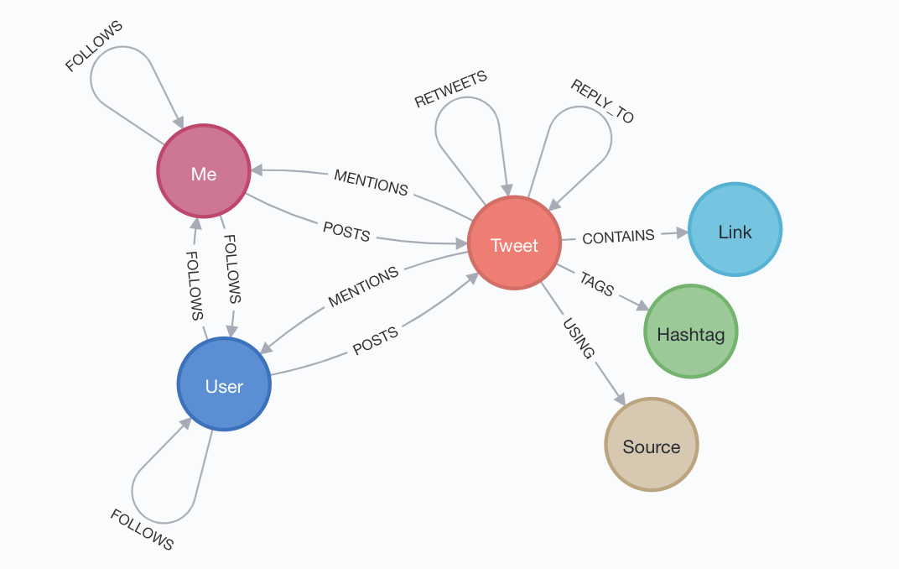
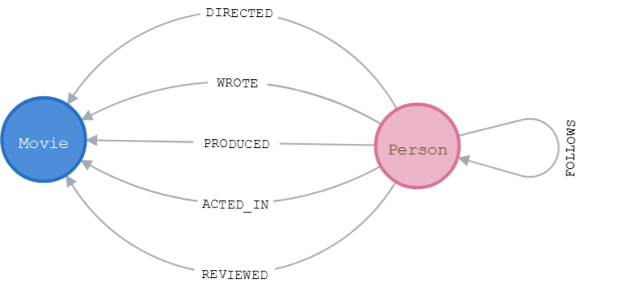
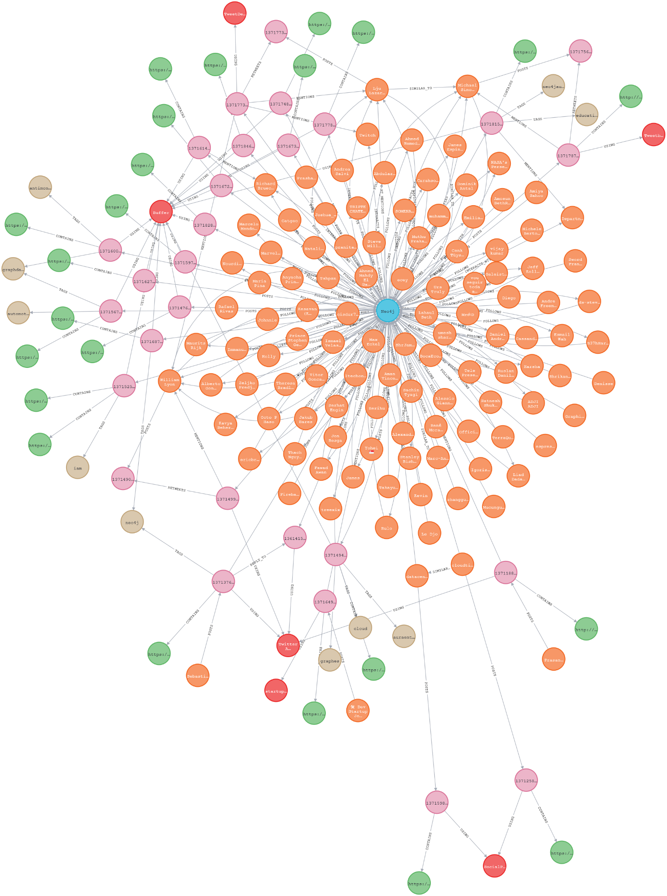
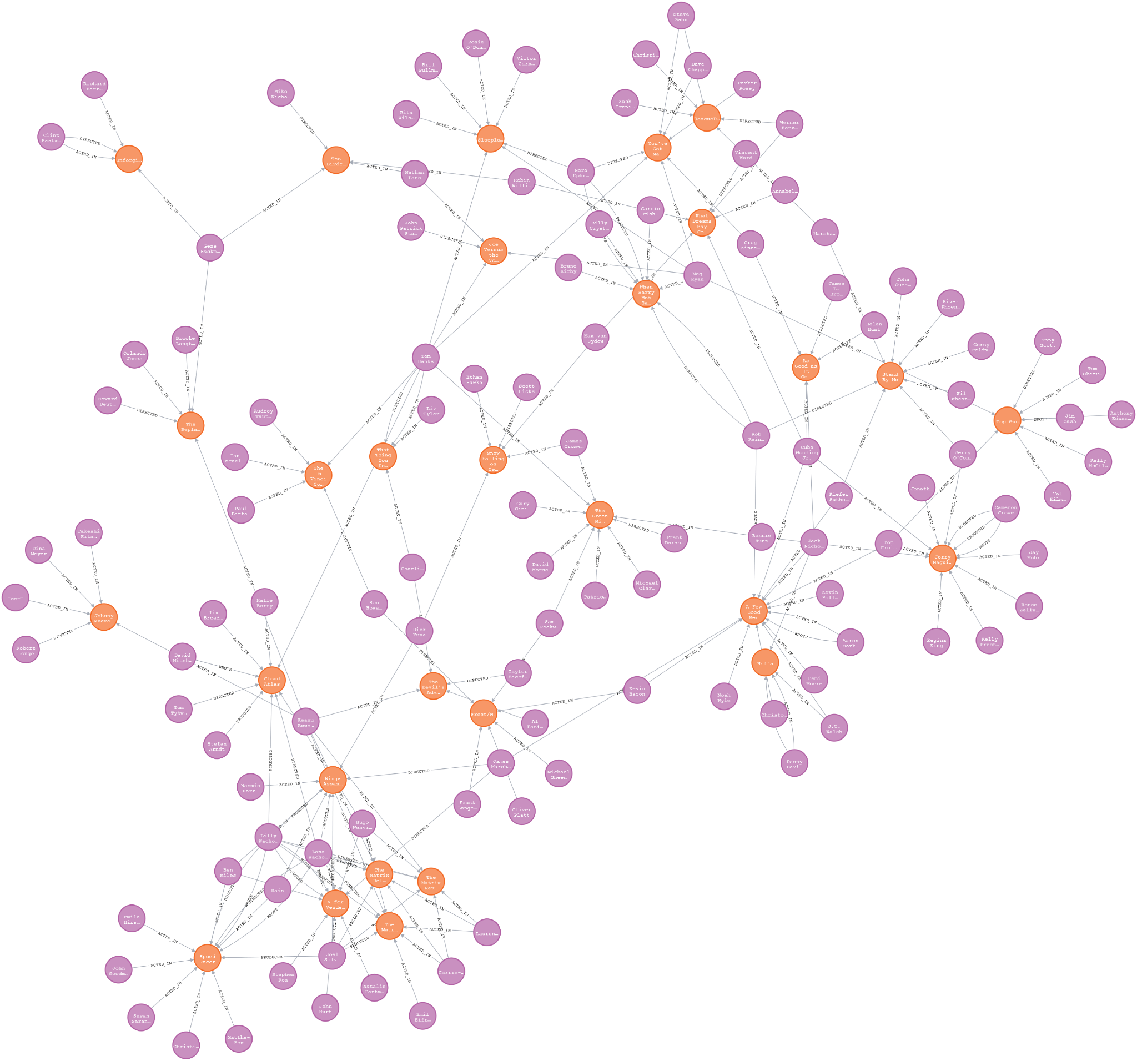
Use Cases:
Twitter and Movies Graph
Notes:
The use cases are a Twitter network property graph and a Movies property graph.
As illustrated, the nodes, with labels as “Me”, “User”, “Tweet”, “Link”, “Hashtag”, “Source”, represent entities and the edges, such as “follows”, “posts”, “mentions”, “retweets”, “reply_to”, “contains”, “tags”, “using”, describe the relationships between those entities. For example, as we can see, a User can post a Tweet and a Tweet can mention a User. Also, Tweets can contain Links, can tag hashtags or use sources.
The Twitter graph data consists of 43325 nodes and 57896 relationships. For example the User node has username as property.
The Movie data consists of 171 nodes and 253 edges.

Slide 9
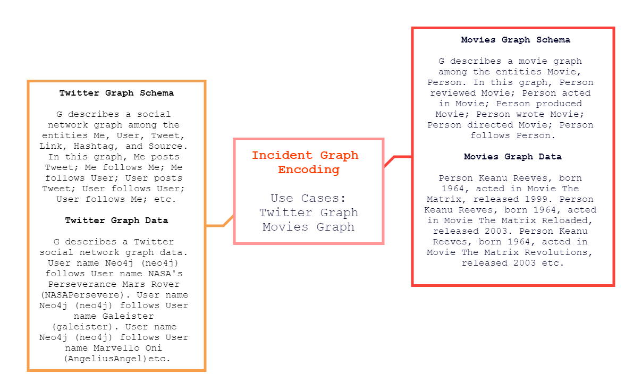
Encoding Graph as Text

Slide 10
Rule Ranking Measures
Estimating the quality of rules
Three ranking measures:
Support = number of instances that satisfy the rule
Coverage = support/total number of instances in the dataset
Confidence = support/number of instances where the body of the rule is satisfied
Notes:
To assess the quality and the effectiveness of rules three ranking measures are employed:
Support is the number of instances where the rule is true or number of instances that satisfy the rule
Coverage is defined as the ratio of the support and the total number of instances in the dataset and shows the proportion of the data that is correctly following the rule compared to all the data that should follow it.
Confidence is defined as the ratio of the support and the number of instances where the body is satisfied and shows the likelihood that if the conditions of a rule are satisfied, then the rule itself will also be satisfied.

Slide 11
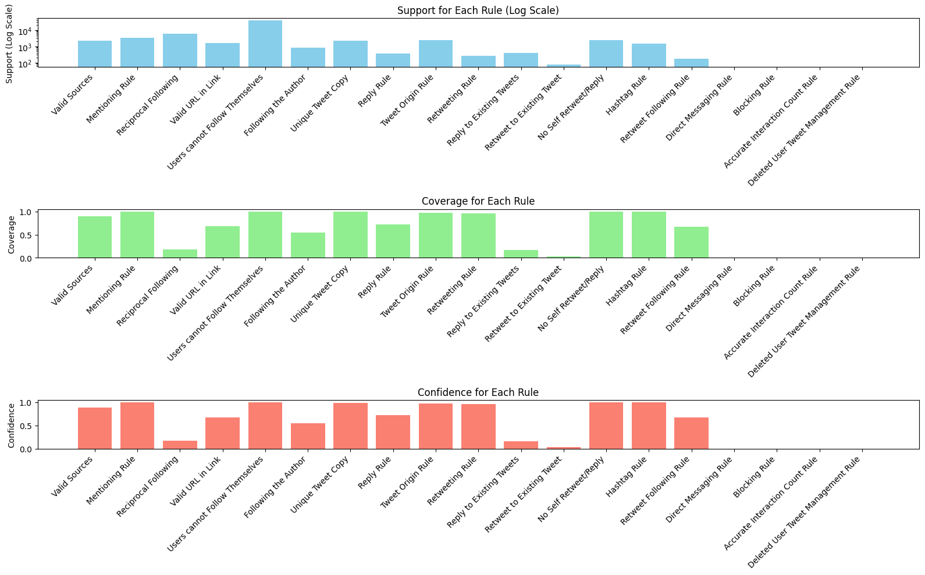
Twitter Schema Rule Ranking Measures
Perfect adherence rules:
Users cannot follow themselves
Tweets should not retweet or reply to themselves
If a Tweet mentions a User, it must have been posted by a User
If a Tweet tags a Hashtag, the Hashtag must be valid
High adherence rules:
Each tweet should be posted by an existing user
If a Tweet retweets another Tweet, the origin of the retweeted Tweet must be different from the origin of the retweeting Tweet.
Tweets are unique by each user
Tweets use sources that are valid
Moderate adherence rules:
If a Tweet is a reply to another Tweet, the original Tweet's poster must be a User.
A retweet should only be possible if the user who is retweeting follows the original poster of the tweet.
Tweets must contain valid URLs in links
If a Tweet mentions a User, the User must follow the person who posted the Tweet
Low adherence rules:
If a User follows another User then the other User should also follow it.
Tweets should retweet and reply to to existing tweets
No adherence rules:
A user cannot direct message another user unless they follow each other.
If a user blocks another, their tweets and any interaction should no longer appear in the blocker's timeline
Notes:
The graph showcases the adherence of various rules extracted from the Twitter schema.
Perfect Adherence Rules: These include rules where there is 100% compliance across the dataset. For example, all users cannot follow themselves, ensuring consistency within user interactions. Similarly, rules such as tweets should not retweet or reply to themselves and that valid hashtags are used also demonstrate perfect adherence.
High Adherence Rules: These rules are mostly followed but may have some exceptions. Examples include the rule that each tweet should be posted by an existing user and that tweets should generally use valid sources.
Moderate Adherence Rules: These are rules where adherence is good but not perfect. For instance, the rule that a tweet replying to another tweet should have the original tweet's poster be a user is followed in most cases but not all.
Conclusion: The results indicate that while most rules are well adhered to, there are areas, such as linking and mentions, where the data could be improved.
Perfect adherence rules:
Users cannot follow themselves
All users perfectly (100%) adhere to the rule. There are no instances of users following themselves
Tweets should not retweet or reply to themselves
All tweets perfectly (100%) adhere to the rule. There are no instances of tweets retweeting or replying to themselves
If a Tweet tags a Hashtag the Hashtag must be valid
All the tweets that tag a hashtag have valid hashtags
High adherence rules:
Each Tweet should be posted by an existing user
Almost all tweets (97,13%) are posted by existing users, which is essential for maintaining the integrity and authenticity of the data
If a Tweet retweets another Tweet, the origin of the retweeted Tweet must be different from the origin of the retweeting Tweet. A user can’t retweet his own tweet
The vast majority (96,26%) of all retweets are from different users
Tweets are unique by each user (no tweets with identical content by the same user)
There is strong compliance (96,2%) with the rule that there are not identical tweets posted by the same user
Tweets use sources that are valid
The majority of tweets (89,15%) correctly use valid source, reflecting good data integrity in source references
Moderate adherence rules:
Tweets must contain valid URLs in links
A significant portion (67,6%) of tweets contain valid URLs in links.
A retweet should only be possible if the user who is retweeting follows the original poster of the tweet
66,79% of retweets follow the rule that the retweeting user follows the original poster
If a Tweet mentions a User, the User must follow the person who posted the Tweet

Slide 12
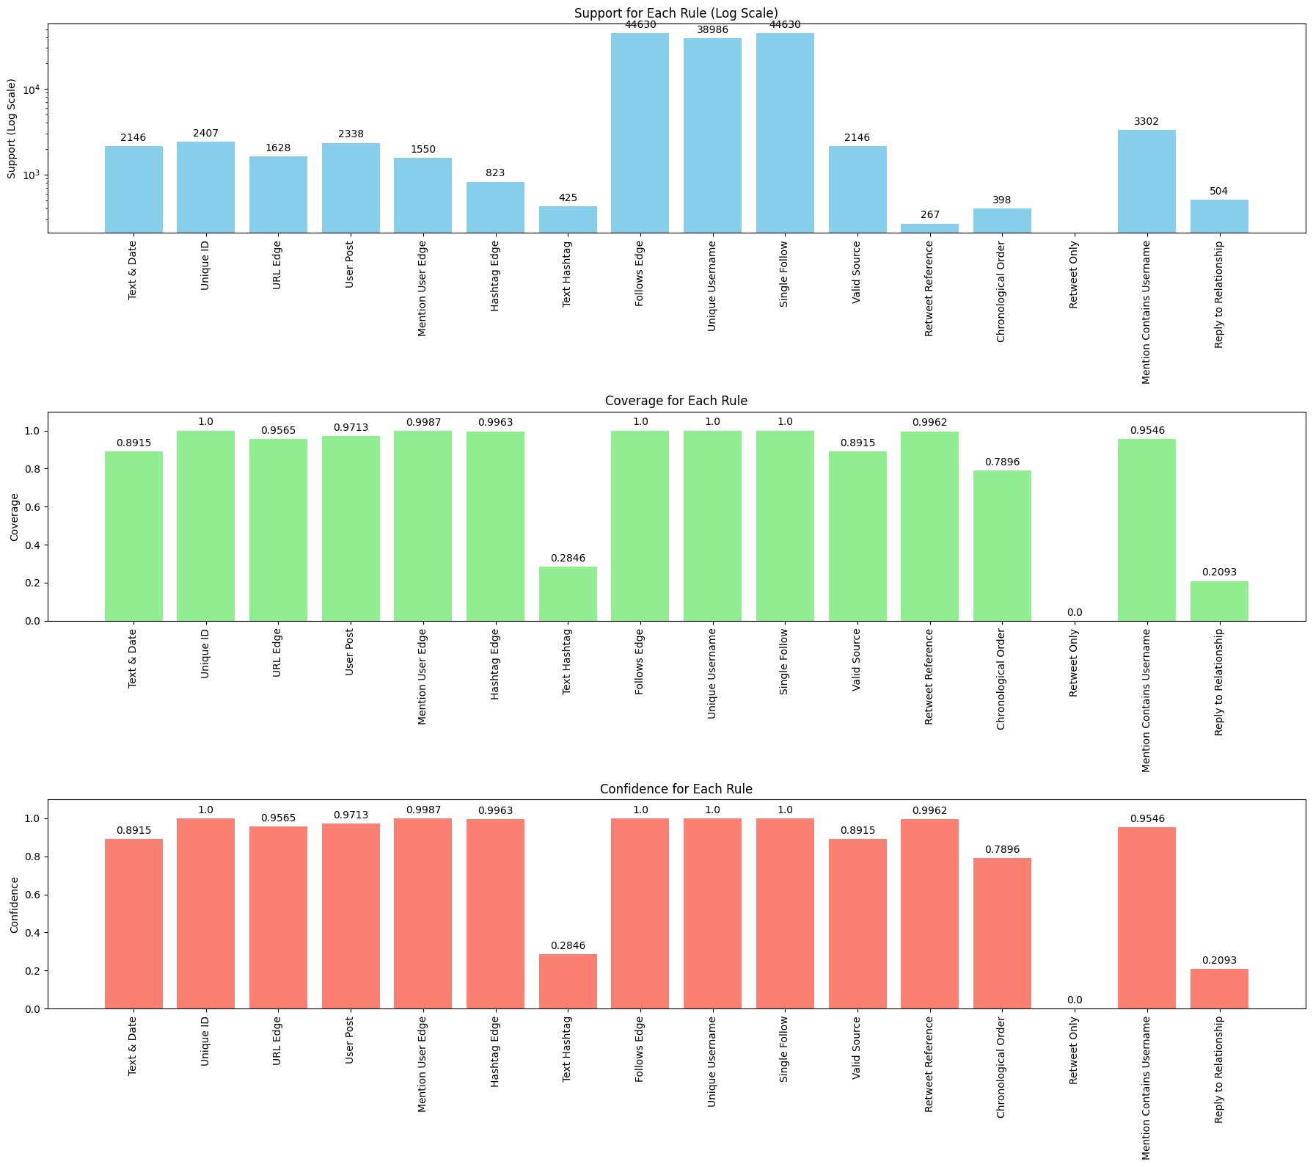
Twitter Data Rule Ranking Measures
Perfect adherence rules:
Every Tweet has a unique ID
Every User has a unique username
If a User follows another user, a directed edge should exist from one user to another
Every User who follows another user follows them only once
High adherence rules:
If a Tweet mentions a user, there should be a directed edge from the tweet to the user
If a Tweet contains a hashtag, there should be an edge from the tweet to the hashtag
A retweeted tweet must reference the original post including the author’s username in its text
Every Tweet has one user who posts it
Moderate adherence rules:
Dates of replies or retweets should not precede the creation date of the original tweet
Low adherence rules:
The tweet text that tags a hashtag should contain that hashtag within it
A reply to a Tweet must have a relationship with the original Tweet
No adherence rules:
If the identical text appears across multiple tweets, it should be a retweet
Notes:
This graph evaluates the adherence of rules within the Twitter database, focusing on data integrity and coherence.
Perfect Adherence Rules: These include rules such as every tweet having a unique ID and every user having a unique username, demonstrating that there are no duplicates or inconsistencies in these fundamental aspects.
High Adherence Rules: The rules such as tweets mentioning users or containing hashtags generally have a high level of adherence, indicating that the data structure is well-maintained. Each Tweet should have text and creation date. Approximately 89,2% of all tweets in my dataset have both a text content and a creation date.
Moderate and Low Adherence Rules: Some rules, like ensuring that replies or retweets are correctly associated with the original tweet, show lower adherence, indicating potential areas for data quality improvement.
The rule If the identical text appears across multiple tweets, it should be a retweet has no adherence meaning that those tweets with identical text are not retweets
Conclusion: The Twitter database rules exhibit strong adherence overall, particularly in areas related to unique identifiers and user relationships, but there are opportunities for enhancing the handling of replies and retweets.
Perfect adherence rules:
Every Tweet has a unique ID
All tweets are perfectly (100%) consistent with the rule. There are no instances of tweets having duplicate IDs
Every User has a unique username
All users are perfectly (100%) consistent with the rule. There are no instances of users having the same username
If a User follows another user, a directed edge should exist from one user to another
All the follows are correctly represented by a directed edge
Every User who follows another user follows them only once
Each user follows another user uniquely
High adherence rules:
If a Tweet mentions a user, there should be a directed edge from the tweet to the user
Out of all tweets that mention a user, 99,87% have a directed edge from the tweet to the user
If a Tweet contains a hashtag, there should be an edge from the tweet to the hashtag
About 99,63% of the tweets have a directed edge to the respective hashtag
A retweeted tweet must reference the original post including the author’s username in its text
About 99,62% of the retweets correctly reference the original post and include the author’s username in the text
Every Tweet has one user who posts it
About 97,13% of the tweets have one user who posted them

Slide 13
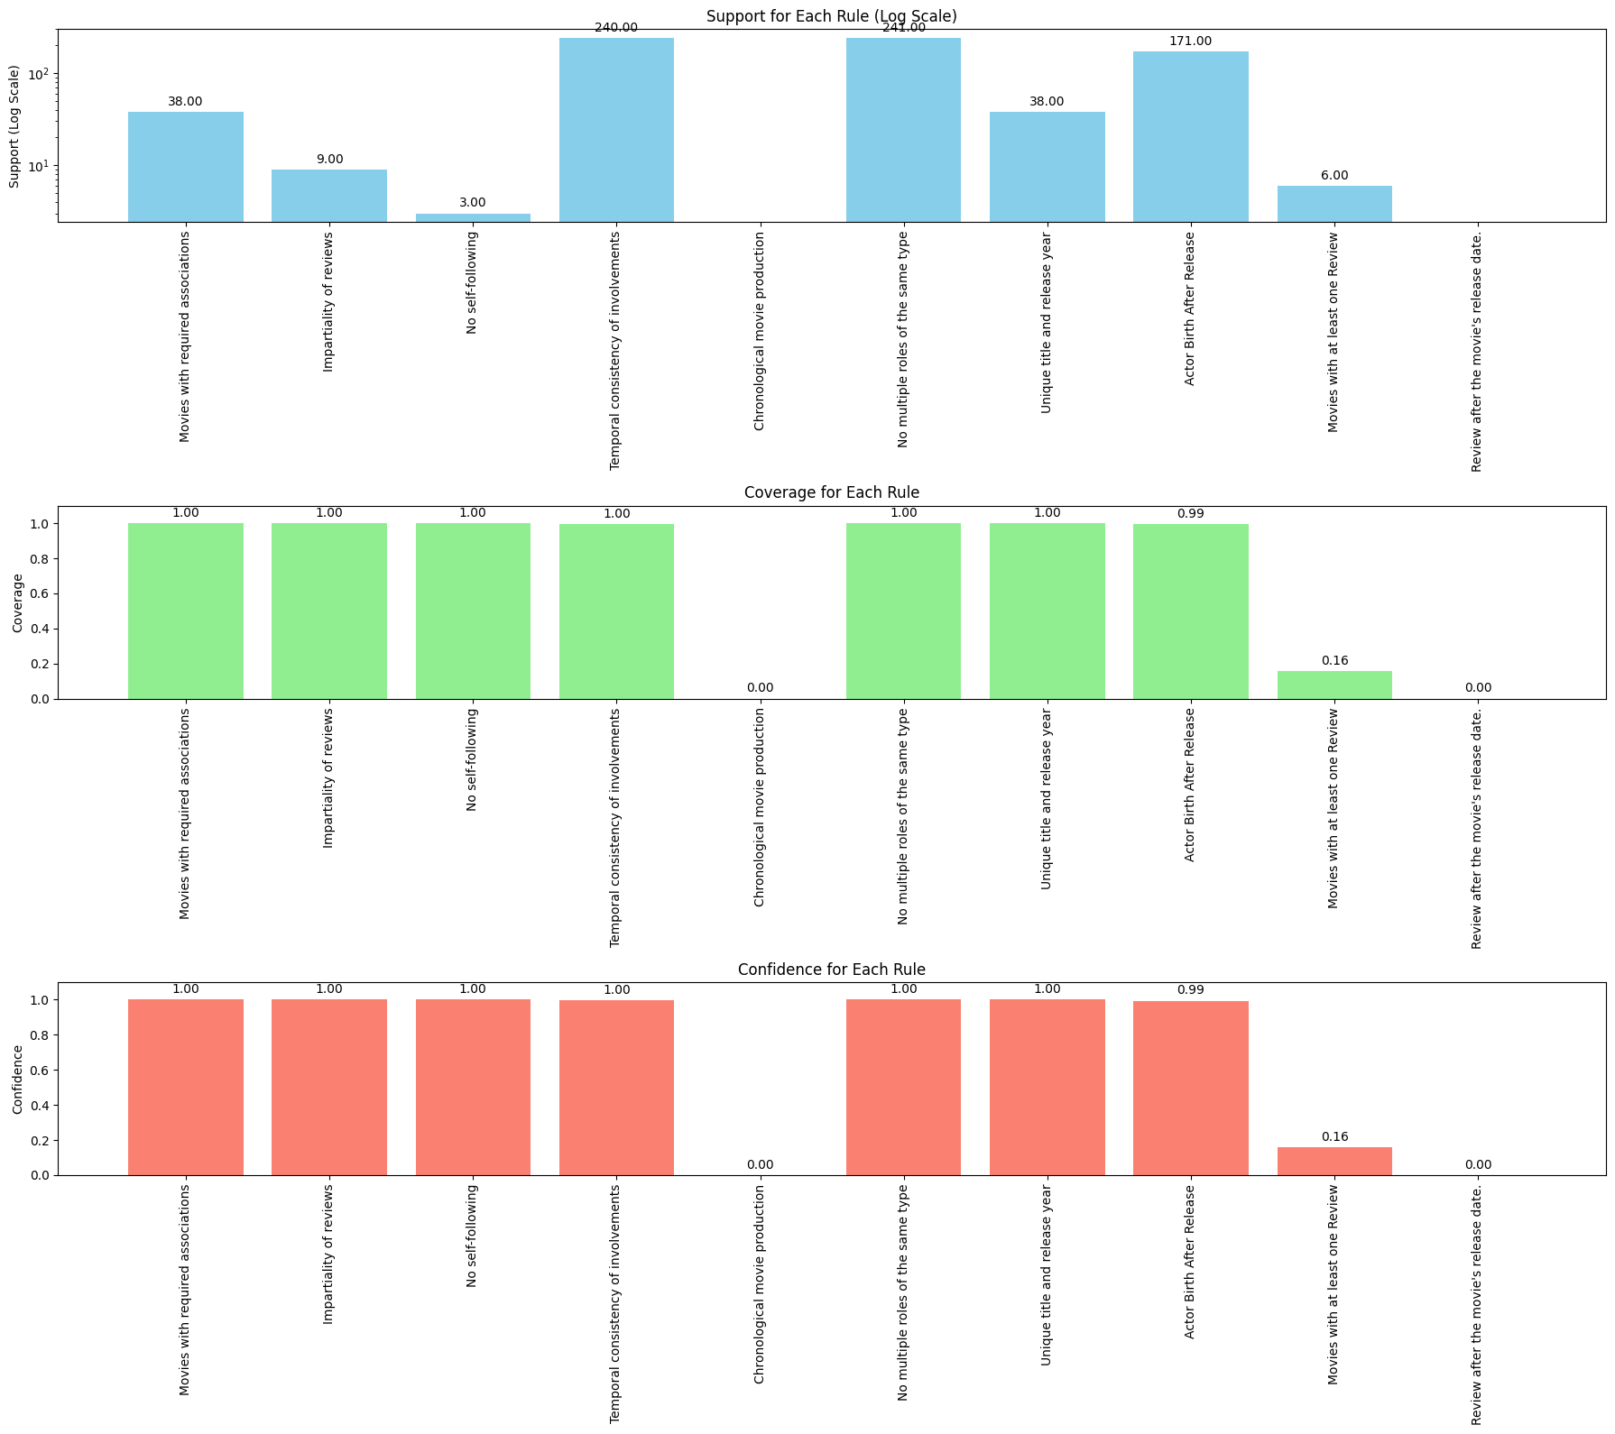
Movies Schema
Rule Ranking Measures
Perfect adherence rules:
A Movie must have at least one Person associated with it in the roles of director, actor, producer, or writer.
A Person can't review a Movie in which they have acted, directed, produced, or wrote.
A Person can't follow themselves.
A Person can't have multiple roles in the same Movie with the same role type.
A Movie must have a unique title and release year combination.
A Movie cannot have an actor born after the release date of the movie
High adherence rules:
A Person can't act, direct, produce, or write a Movie before their date of birth
Low adherence rules:
A Movie must receive at least one Review to be considered active
No adherence rules:
A Movie can't be released before it was written, produced, directed or acted.
A Review of a Movie must be written after the movie's release date
Notes:
In this slide i will discuss the adherence of different consistency rules that were inferred from the movies schema.
Perfect Adherence Rules: These include critical rules like ensuring every movie has at least one person associated with it and that titles and release years are unique, ensuring basic data consistency. A Person can’t have multiple roles in the same Movie with the same role type. There are no persons having multiple roles in the same Movie with the same role type.
High Adherence Rules: An example is the rule that individuals cannot be involved in movie production roles before their birthdate, which is followed almost universally.
Low and No Adherence Rules: Rules such as a movie needing at least one review to be considered active, or the chronological consistency of reviews, show lower adherence. For the rule a movie needing at least one review to be considered active this could indicate issues with incomplete data or a large number of movies that have not been reviewed.
Conclusion: The majority of rules demonstrate perfect adherence, ensuring the integrity of the movie schema, but specific areas, such as reviews, need attention to improve data reliability.
Perfect adherence rules:
A Movie must have at least one person associated with it in the roles of director actor producer or writer
All movies perfectly (100%) adhere to the rule. All movies have at least one person associated with it in the roles of director actor producer or writer
A Person can’t review a Movie in which they have acted directed produced or wrote
All persons perfectly adhere to the rule
A Person can’t follow themselves
There are no persons following themselves
A Person can’t have multiple roles in the same Movie with the same role type. For example a Person can’t be listed as a director of the same Movie more than once
There are no persons having multiple roles in the same Movie with the same role type
A Movie must have a unique title and release year combination
All movies perfectly (100%) adhere to the rule. All movies have a unique title and release year combination
A Movie cannot have an actor born after the release date of the movie
All movies comply (100%) with the rule that the actor was born before the release date of the movie
High adherence rules:
A Person cannot act direct produce or write a Movie before their date of birth
Almost all persons (99,58%) comply with the rule that the person’s involvement in the movie happened after their birth year
Low adherence rules:
A Movie must receive at least one Review to be considered active
A small portion (16%) of movies have at least one Review
No adherence rules:
A Movie cannot be released before it was written produced directed or acted
A Review of a Movie must be written after the movie s release date

Slide 14
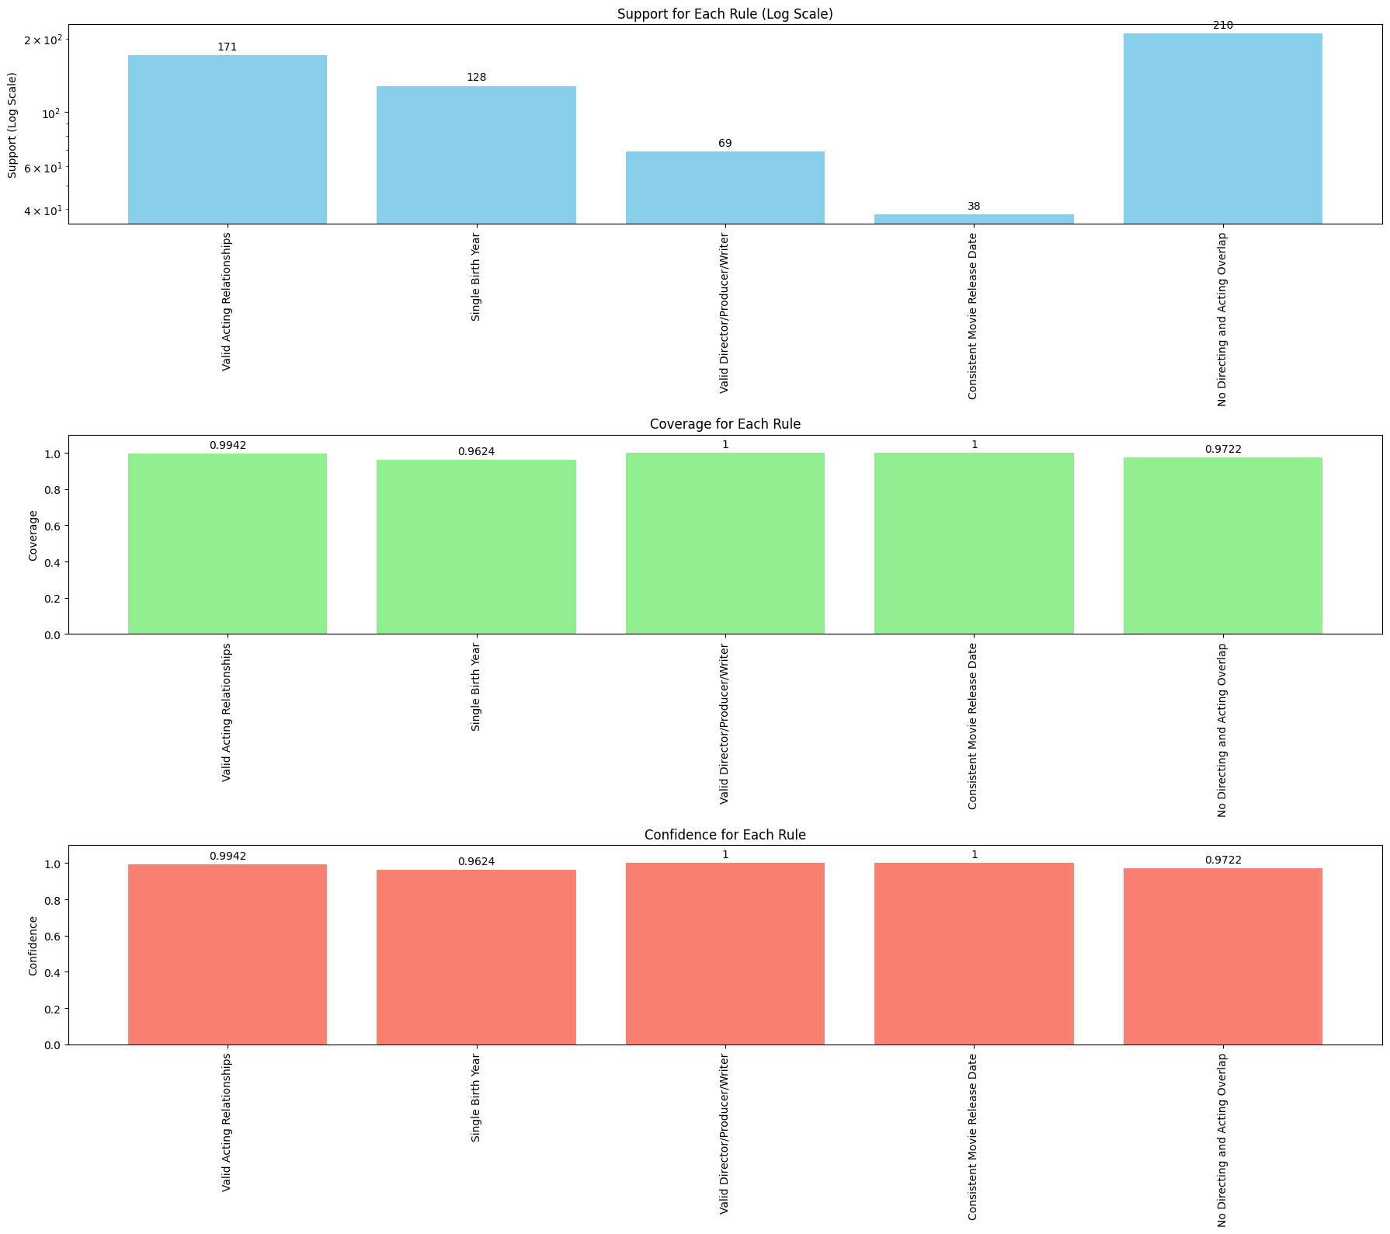
Movies Data
Rule Ranking Measures
Perfect adherence rules:
If a person is listed as the director, producer, or writer of a movie, they must be associated with the film's release year and should be born before the movie release year.
A movie can have multiple actors, but a release date should be consistent for a specific movie throughout the graph.
High adherence rules:
If a person acts in a movie, the movie's release year should be later than the birth year of the person.
If a person directed a movie, they cannot act in the same movie
Persons can only have one birth year.
Notes:
This slide presents the adherence of rules within the movies dataset, emphasizing data consistency in cinematic productions.
Perfect Adherence Rules: Key rules, such as If a person is listed as the director, producer, or writer of a movie, they must be associated with the film's release year and should be born before the movie release year, show perfect adherence, A person must have been alive when the movie was released.
In real world scenarios this rule is perfectly followed as it adheres to basic temporal logic-no one can direct produce or write a movie before they were born.
High Adherence Rules: Rules like ensuring that actors are born before the movie’s release year are mostly followed, with minor exceptions that may be due to data entry errors.
The rankings confirmed strong adherence to key rules.
Perfect adherence rules:
For every person listed as the director producer or writer of a movie the person’s birth year is before the movie’s release year. A person must have been alive when the movie was released.
In real world scenarios this rule is perfectly followed as it adheres to basic temporal logic-no one can direct produce or write a movie before they were born
High adherence to the rule If a person acts in a movie the movie’s release year should be later than the birth year of the person indicates that while most of the data adheres to this logic there might be few instances where inconsistencies exist. Also the majority of cases follow the rule that someone listed as a director doesn’t appear as an actor in the same film though exceptions exist.
And for the rule Persons can only have one birth year high adherence indicates that there might be a few inconsistencies, possibly due to data duplication or incorrect data entries, but the majority of the dataset is accurate.
High adherence rules:
If a person acts in a movie the movie’s release year should be later than the birth year of the person.
Almost all persons acted in a movie (99,42%) the movie’s release year is later than the birth year of the person
If a person directed a movie they cannot act in the same movie
Almost all persons (97,22%) directed a movie but they don’t act in the same movie
In this dataset this rule is applied in almost all persons but it’s not a rule that it is always applicable in real life
Persons can only have one birth year
There is strong compliance (96,24%) with the rule

Slide 15
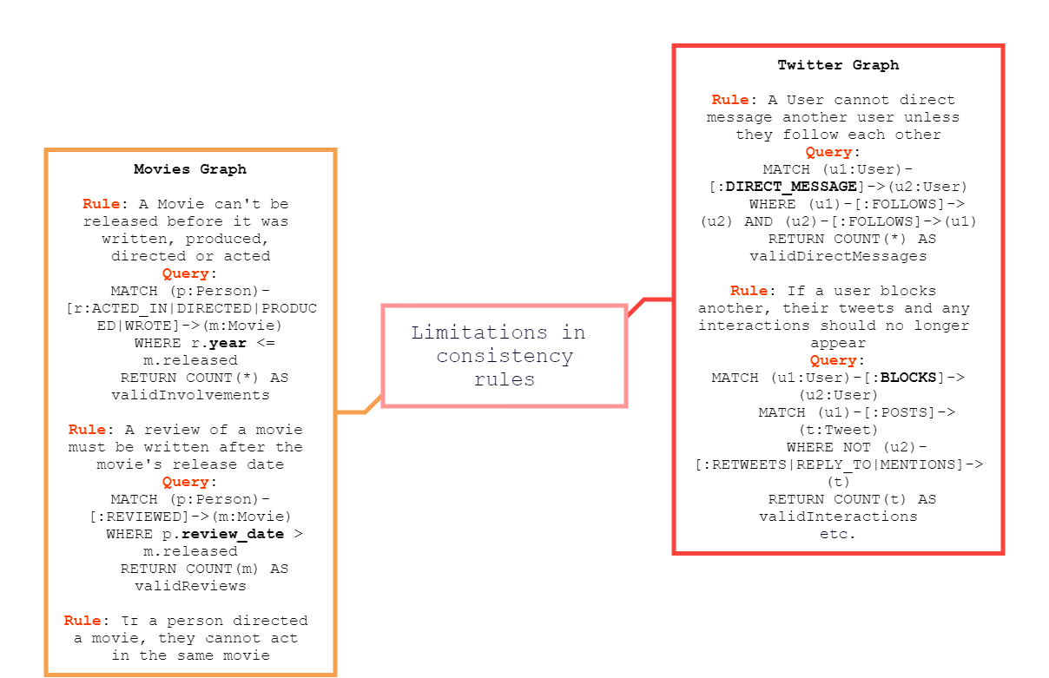
Discussion
https://github.com/michaloudi/Internship/blob/main/ExperimentDesign_Analysis(2).ipynb
Notes:
Large Language Models have demonstrated capabilities in generating consistency rules.
However there are some limitations associated with some of the rules generated.
Concerning the use case of twitter an issue arise with the rule A User cannot direct message another user unless they follow each other. The lack of direct messaging relationship in database means that this rule cannot be validated.
Ensuring privacy and preventing unwanted interactions is crucial as highlighted by the rule If a User blocks another their tweets and any interactions should no longer appear. The inability to validate this rule stems from the lack of blocks relationship in database.
Concerning the use case of movies a significant challenge arises with the rule A Movie cannot be released before it was written produced directed or acted. This rule ensures chronologically consistency in movie production. There is an absence of a year property in the relationships and with this absence it is impossible to validate this rule.
Similarly the rule A Review of a movie must be written after the movie s release date aims to ensure that the reviews are temporally consistent with the release dates of movies.
The failure to calculate ranking measures arises from the absence of a review date property in the Person node. This underscores the importance of comprehensive and correctly attributed data properties in validating consistency rules.
The rule If a person directed a movie they cannot act in the same movie is intended to maintain distinct roles for individuals within a movie. Real life examples of individuals who both direct and act in the same movie render this rule impractical.

Slide 16
Conclusion
Ability and efficiency of LLMs to generate and evaluate consistency rules
Limitations in applying rules
Further research in expanding the scope of datasets
Notes:
This research has demonstrated the effectiveness and efficiency of Large Language Models in automatically inferring and evaluating consistency rules within complex graph structures such as those representing twitter network and movie industry relationships.
The study revealed some challenges when applying the rules due to absence of certain properties or relationships.
Future research could focus on refining Large Language Models to better expanding the scope of datasets to test the capabilities of models across various domains

Slide 17
Thank you for your attention.

